Slide 1
Lecture 10: Graph-Path-Circuit
Other Types of Graphs:
  Multigraphs
  Directed Graphs
  Directed Multigraphs
Paths and Circuits:
  Basic Definitions
  Euler Paths and Circuits
  Hamilton Paths and Circuits

Slide 2
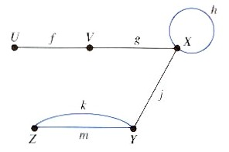
12.1. Multigraphs
A multigraph G = (V, E):
  Is a graph where we allow
    A loop, i.e. an edge to join a vertex to itself and
    Several edges joining the same pair of vertices.
  Such a graph is also called undirected multigraph.
  Examples:

Slide 3
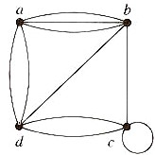
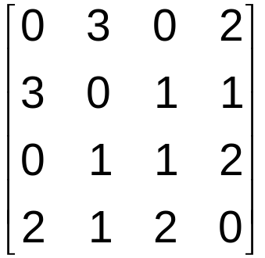
12.1. Multigraphs
  Examples (continued):
    Adjacency matrix of a multigraph:
      deg(a) = 5
      deg(4) = 4

Slide 4
12.2. Directed Graphs
A directed graph G = (V, E):
  Is a graph where an edge represents a one-way relation only.
    Cf. undirected graph – an edge represents two-way or symmetric relationship between two vertices.
  The number of directed edges which initiate from vertex v is called the outdegree of v or outdeg(v).
  The number of directed edges which terminate at vertex v is called the indegree of v or indeg(v).

Slide 5
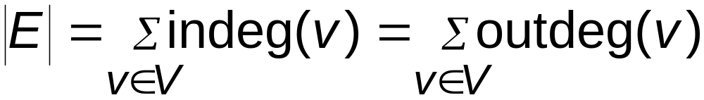
12.2. Directed Graphs
  Theorem:

Slide 6
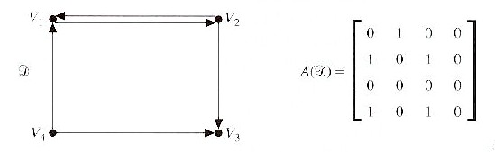
12.2. Directed Graphs
  Examples (continued):
    Adjacency matrix of a directed graph:
      outdeg(V₁) = 1, indeg(V₁) = 2
      outdeg(V₃) = 0, indeg(V₃) = 2
      outdeg(V₄) = 2, indeg(V₄) = 0
Notes:
Sum of rows give us outdegree.
Sum of columns give us indegree.

Slide 7
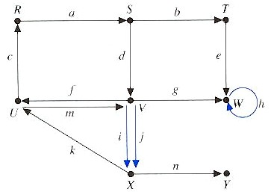
12.3. Directed Multigraphs
A directed multigraph G = (V, E):
  Is a directed graph where we allow
    A directed loop, i.e. a directed edge from a vertex to itself and
    Several parallel directed edges from a vertex to another.
  Examples:

Slide 8
12.4. Paths and Circuits
A u-v walk from u to v:
  Is an alternating sequence of vertices and edges
  V₁, e₁, V₂, e₂, V₃, e₃, …, V_{n}, e_{n}, V_{n+1}
  where
    the first vertex V₁ is u and
    the last vertex V_{n+1} is v and
    the edge e_{i} joins V_{i} and V_{i+1} for i = 1, 2, …, n.
  The length of this walk is n.
  A walk provides a way of describing how to go from one vertex to another by following edges.
    The vertices and the edges may be repeated.
Notes:
May not be the most efficient route.
Simple path is an efficient route between vertices.
The path or cirucit is said to pass through or traverse the vertices V1, V2, … Vn.

Slide 9
12.4. Paths and Circuits
A u-v path:
  Is a walk from u to v in which no vertex, and hence, no edge is repeated.
A circuit:
  Is an walk that begins and ends at the same vertex, i.e. if u = v, and no edge is repeated.
When there is no chance of confusion, a path can be represented by:
  The vertices V₁, V₂, V₃, …, V_{n}, V_{n+1} only or
  The edges e₁, e₂, e₃, …, e_{n} only.

Slide 10
12.4. Paths and Circuits
Examples:
  U, f, V, g, X or f, g is a path of length 2 from U to X.
  f, g, h is a walk of length 3 from U to X.
  U, V, Z, Y is not a path since { V, Z } is not an edge.
  U, f, V, f, U is a walk of length 2 from U to U.
  Z,k,Y,m,Z is a circuit of length 2

Slide 11
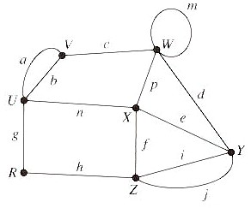
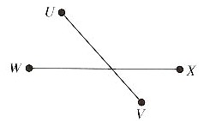
12.4. Paths and Circuits
Connected:
  A graph is called connected if there is a path between every pair of vertices.
  Examples:
Connected
Not connected
Notes:
Graph G is connected since a path can be found between any two vertices.
Graph H is not connected since there is no path from vertex U to vertex W.

Slide 12
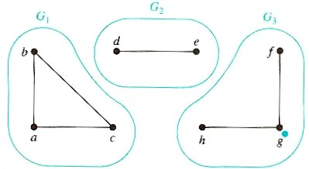
12.4. Paths and Circuits
(Connected) components of a graph G:
  Are the maximally connected subgraphs of G.
  Examples:
    Graph G is not connected since it is a union of three disjoint connected subgraphs G₁, G₂, and G₃.
    G₁, G₂, and G₃ are the components of graph G.

Slide 13
12.5. Euler Paths and Circuits
An Euler path in graph G:
  Is a path that includes exactly once all the edges of G.
An Euler circuit in graph G:
  Likewise, but with same starting and ending vertices
Notes:
Two conditions – connected and degree of each vertex is even.
Application – in testing a communication network. It is often necessary to examine each link in the system. In order to minimize the cost of such a test, it is desirable to device a route that goes through each edge exactly once.

Slide 14
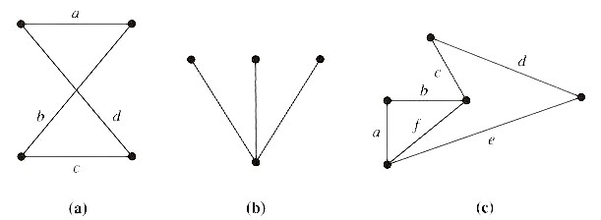
12.5. Euler Paths and Circuits
Examples:
  The path a, b, c, d in (a) is an Euler circuit since all edges are included exactly once.
  The graph (b) has neither an Euler path nor circuit.
  The graph (c) has an Euler path a, b, c, d, e, f but not an Euler circuit.
Notes:
To include all three of the edges in the path, we would have to backtrack and use an edge twice.

Slide 15

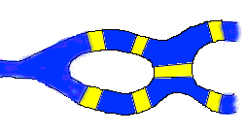
12.5. Euler Paths and Circuits
Historical note
  In Europe: Konigsberg 7-bridge problem
    Konigsberg, originally in Prussia, now in Russia
    Four sections, two rivers, seven bridges
    Euler solved this problem in 1736; the origin of graph theory
Notes:
To include all three of the edges in the path, we would have to backtrack and use an edge twice.

Slide 16
12.5. Euler Paths and Circuits
Problem: Draw a path (or circuit) with a pencil in such a way that you trace over each bridge once and only once and you complete the 'plan' with one continuous pencil stroke

Slide 17
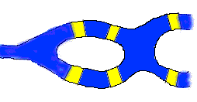
12.5. Problem Variations
Problem 2
Suppose they had decided to build one fewer bridge in Konigsberg, so that the map looked like this:
Problem 3
Does it matter which bridge you take away? What if you add bridges? Come up with some maps on your own, and try to 'plan your journey' for each one

Slide 18
12.5. Euler Paths and Circuits
Problem: Draw a path (or circuit) with a pencil in such a way that you trace over each bridge once and only once and you complete the 'plan' with one continuous pencil stroke

Slide 19
12.5. Euler Circuits
Theorem:
  A connected multigraph has an Euler circuit if and only if the degree of each vertex is even.
Why ?
Notes:
Two conditions – connected and degree of each vertex is even.
Application – in testing a communication network. It is often necessary to examine each link in the system. In order to minimize the cost of such a test, it is desirable to device a route that goes through each edge exactly once.

Slide 20
12.5. Euler Circuits
Theorem:
  A connected multigraph has an Euler circuit if and only if the degree of each vertex is even.
Proof (Basic idea) :
  For each vertex, if there is one “in”, there must be one “out”, because this is a circuit.
Notes:
Two conditions – connected and degree of each vertex is even.
Application – in testing a communication network. It is often necessary to examine each link in the system. In order to minimize the cost of such a test, it is desirable to device a route that goes through each edge exactly once.

Slide 21
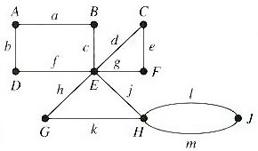
12.5. Euler Circuits
Examples:
  Construct an Euler circuit for the following graph.
  Solution:
    The graph is connected and the degree of each vertex is even. So, it has an Euler circuit.

Slide 22
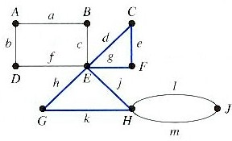
12.5. Euler Circuits
  Procedure for constructing an Euler circuit:
    Select any vertex u, and construct a path P₁ from u to u by randomly selecting unused edges for as long as possible.
      e.g. if we start at G, we may construct the path:
      P₁: G, h, E, d, C, e, F, g, E, j, H, k, G
Notes:
Such a path must return to the starting vertex because the degree of each vertex is even and the number of vertices is finite.

Slide 23
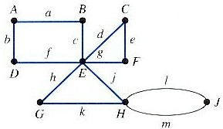
12.5. Euler Circuits
  Procedure (continued):
    Since the multigraph is connected, there must be a vertex in P₁ that is incident with an edge not in P₁.
      In this case, the vertices E and H are such vertices.
    Arbitrarily choose one of these, say E, and construct a path P₂ from E to E.
      P₂: E, c, B, a, A, b, D, f, E

Slide 24
12.5. Euler Circuits
  Procedure (continued):
    Enlarge P₁ to include the path P₂ by replacing any one occurrence of E in P₁ by P₂.
      e.g. replace the first occurrence of E in P1:
      P₁: G, h, E, c, B, a, A, b, D, f, E, d,
      C, e, F, g, E, j, H, k, G
    Repeat the above process.
      Construct a path P₃ from H to H and enlarge P₁ by P₃, we obtain the Euler circuit.
      P₁: G, h, E, c, B, a, A, b, D, f, E, d,
      C, e, F, g, E, j, H, m, J, l, H, k, G

Slide 25
12.5. Euler Paths
Theorem:
  A connected multigraph has an Euler path but not an Euler circuit if an only if it has exactly two vertices of odd degree.
Why ?
Notes:
Two conditions – connected and degree of each vertex is even.
Application – in testing a communication network. It is often necessary to examine each link in the system. In order to minimize the cost of such a test, it is desirable to device a route that goes through each edge exactly once.

Slide 26
12.5. Euler Paths
Theorem:
  A connected multigraph has an Euler path but not an Euler circuit if an only if it has exactly two vertices of odd degree.
Proof:
  If: add one edge connects the two vertices of odd degree
Notes:
Two conditions – connected and degree of each vertex is even.
Application – in testing a communication network. It is often necessary to examine each link in the system. In order to minimize the cost of such a test, it is desirable to device a route that goes through each edge exactly once.

Slide 27
12.5. Euler Paths/Circle in Complete Graphs
K2
K6
K2: Euler path – ?
Euler cycle – ?
K3: Euler path – ?
Euler cycle – ?
K4: Euler path – ?
Euler cycle – ?
K5: Euler path – ?
Euler cycle – ?
K6: Euler path – ?
Euler cycle – ?
K8: Euler path – ?
Euler cycle – ?
K3
K8
K4
K5
Notes:
Two conditions – connected and degree of each vertex is even.
Application – in testing a communication network. It is often necessary to examine each link in the system. In order to minimize the cost of such a test, it is desirable to device a route that goes through each edge exactly once.

Slide 28
12.5. Euler Paths/Circle in Complete Graphs
K2
K6
K2: Euler path – Yes
Euler cycle – No
K3: Euler path – No
Euler cycle – Yes
K4: Euler path – No
Euler cycle – No
K5: Euler path – No
Euler cycle – Yes
K6: Euler path – No
Euler cycle – No
K8: Euler path – No
Euler cycle – No
K3
K8
K4
K5
Notes:
Two conditions – connected and degree of each vertex is even.
Application – in testing a communication network. It is often necessary to examine each link in the system. In order to minimize the cost of such a test, it is desirable to device a route that goes through each edge exactly once.

Slide 29
12.6. Hamilton Paths and Circuits
A Hamilton path in graph G:
  Is a path that includes each vertex once and only once.
Notes:
Since we want ot avoid repetition of vertices, loops and parallel edges will not be of any assistance. Consequently, we may assume that we are working with a graph.

Slide 30
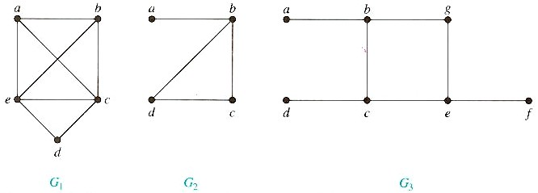
12.6. Hamilton Paths and Circuits
Examples:
  G₁ has a Hamilton path: a, b, c, d, e.
  G₂ has only a Hamilton path: a, b, c, d.
  G₃ has no.
  In general, no efficient method to find such a path
Notes:
G2 has not circuit, because to cotain every vertex, it must contain edge {a, b} twice.
G3 has not since any path containing all vertices must contain one of the edges {a, b}. {e, f} and {c, d} more than once.

Slide 31
12.7. Further Readings
Other Types of Graphs:
  Multigraphs : Section 11.1.
  Directed Graphs : Section 11.1.
  Directed Multigraphs : Section 11.1.
Paths and Circuits:
  Euler Paths and Circuits : Section 11.3.
  Hamilton Paths and Circuits : Section 11.5.

